Slide 1
3 – Train and deploy a machine learning model on Azure with Azure ML
Custom model, training task, batch/streaming inference, endpoint scaling, A/B testing

Slide 2
01
Introduction and goals
04
Endpoint scaling
Cloud advantages
Definition & test
02
Model training on the cloud
Data, Azure Machine Learning
03
Deploying an endpoint
Specificities, Batch inference V.S. streaming

Slide 3
Introduction
Session’s goals and cloud computing

Slide 4
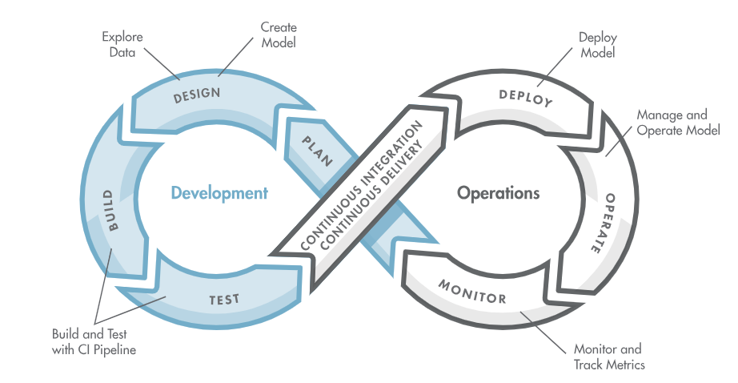
Introduction & objectives
Last week :
Introduction to MLOps
Introduction to mlflow
Today’s agenda:
Train a neuronnal network on a dataset
Optimising its hyperparameters
Deploying for both Real-Time & Batch inference
Load testing the scaling
These steps will be done using Azure Cloud

Slide 5
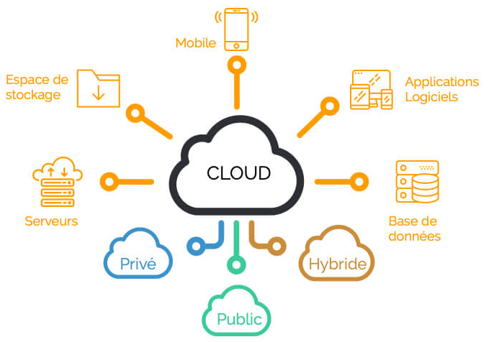

Introduction & objectives
What’s a cloud ?
Set of computing resources (processing, storage, network) accessible remotely via the Internet On-demand services without direct management of the physical infrastructure
Different cloud types :
Public clouds
Private clouds
Hybrid clouds
Major suppliers :
Awazon Web Services (AWS) (~30% market share*)
Microsoft Azure (~21% market share*)
Google Cloud Platform (GCP) (~12% market share*)
We will continue on Azure.
* Sources : Statista
Notes:
Added market share

Slide 6






Key components (without AI) :
Ressource group
Virtual Network
Group for organizing and managing Azure resources
Isolated private network in Azure for secure resource connectivity
Container App
Container Registry
Serverless platform for running containerized microservices
Private Docker registry to store and manage container images
Storage
Application Gateway
Traffic manager for web apps with built-in security
Scalable cloud storage for files
Notes:
Added market share

Slide 7



How to interact with clouds :
Command Line Interface
Software Developement Kit (SDK)
Command-line tool to control Azure from your terminal
Python library to automate and manage Azure services
Infrastructure as Code
Method to manage and deploy infrastructure using code instead of manual processes, via configuration files
* Sources : Statista
Notes:
Added market share

Slide 8
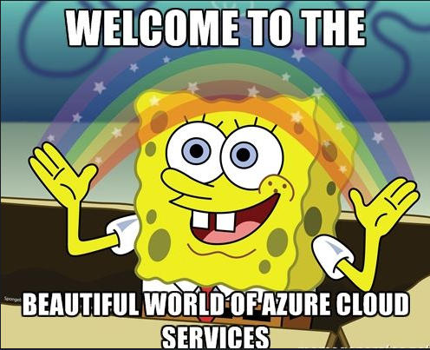
Introduction & objectives
Why should we use a cloud for today’s session ?
AI in Azure ? Azure Machine Learning
For model training:
Access to computing power (CPU/GPU), potentially long training duration
Scaling up ressources is easy for tougher workloads
Optimize training hyperparameters
Parallel launch of multiple trainings with different parameters in Integrated tools
Reduced cost for unpromising trainings
Model deployment:
Azure Machine Learning provides managed endpoints
Scalable endpoint for inference

Slide 9
Model training
Data, Azure hands-on

Slide 10
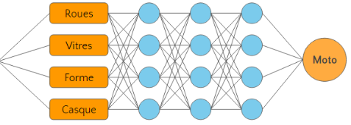

Training dataset
What is MNIST ?
Modified National Institute of Standards and Technology
70 000 digit greyscale images
60 000 training images & 10 000 images in the test set
Created by Yan LeCun
Why this dataset ?
Staple dataset for ML algorithms
Simple
Ideal for discovering purposes
3

Slide 11

Model training
Part 1 of the lab !

Slide 12
Hyperparameter tuning
What’s hyperparameter tuning ?
Aims to find the best hyperparameters of a model (batch size, number of hidden layers…)
Not to be confused with model parameters (weight and bias of each neuron)
These high-level hyperparameters will influence model training
In this lab, Azure provides us with one method : sweep()
Define a search space : give ranges of values for each hyperparameter you want to tune
sweep() will test all or some combinations of hyperparameters and output the best result
You also need to choose a tolerance threshold that allows you to stop training if it becomes clear that the model will not perform well
Notes:
Added « not to be confused with model parameters [… ]»

Slide 13
Model deployment
Specificities, Batch inference V.S. streaming

Slide 14
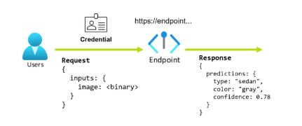
Endpoints & Deployments
Endpoint ?
An endpoint is a server that handles incoming requests. It distributes the necessary computations to provide responses with minimal latency.
By exposing a model through an API, applications can send data and receive predictions.
Deploying to an endpoint involves allocating a resource that hosts a model and makes it accessible via an API for inference.

Slide 15


Batch vs Streaming
Batch inference
Real-Time (Streaming) inference
Idea: Process large volumes of data by parallelizing computations, particularly using GPUs.
Accelerates data processing and optimizes compute resource utilization, thereby reducing operational costs.
May introduce inference latencies (wait for the batch to be filled, then you can start processing)
Examples :
Image classification, Hyperparameter tuning, Large workflow scheduled every night
Idea: Process data in real time as it is collected.
Real-time processing
Requires an efficient preprocessing pipeline
The need for real-time or near-real-time response limits the complexity of models that can be used
Examples:
Recommendation systems, Chatbots

Slide 16
Scaling up an endpoint
Using Locust

Slide 17
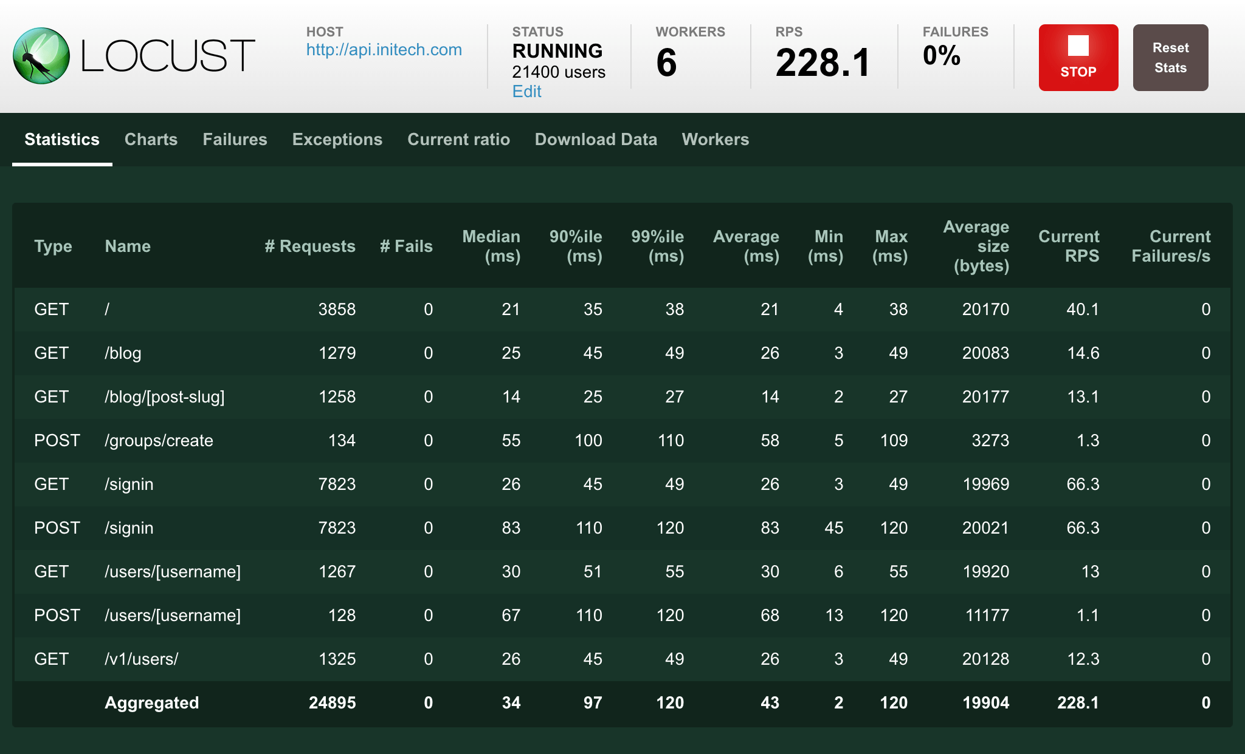
Scaling up endpoint capacities
We will test the service's ability to handle increased traffic
Sending a large number of API requests in parallel
Monitoring average response time and number of errors
Utilisation de Locust :
Open source python library for load testing
Allows simulation of multiple simultaneous users
Praised for its intuitive interface

